Slide 1
Happy Monday!
Sit in a seat you have never sat in before
Preferably next to some folks you have never sat with before
Go to today’s Class Agenda on Canvas (Week 3 → 07/10/19 Class Agenda)

Slide 2
Hands-on exercise 1
Create a 2×2 matrix Amat and a 2×3 matrix Bmat, each filled with unique numbers
Combine A and B into a 2×5 matrix Cmat and a 5×2 matrix Dmat
Create a factor Xfactor from the following vector such that 1 is female and 2 is male
sex <- c(1,1,2,1,2,2,2,1,1,1)
Create a list called data that contains matrices Amat, Bmat and Xfactor
Extract the first row of the matrix Amat from the list data
Change to NA the value in row 1 and column 1 of matrix Bmat within data.

Slide 3
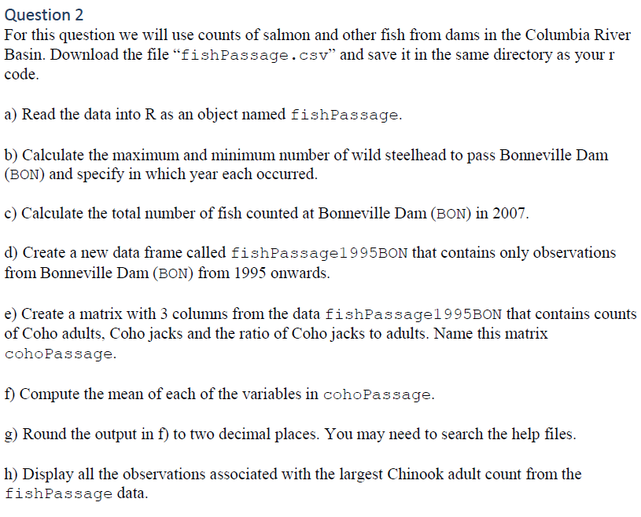

Slide 4
The factor function
We can specify a categorical variable as a factor with the factor() command
> zone <- c("demersal", "pelagic", "reef", "demersal")
> is.factor(zone)
[1] FALSE
> zone.fac <- factor(zone)
> zone.fac
[1] demersal pelagic reef demersal
Levels: demersal pelagic reef
> is.factor(zone.fac)
[1] TRUE

Slide 5
Numbers to factors
Often a categorical variable is coded numerically in a database; then the labels argument can be used:
> zone <- c(1, 1, 1, 2, 2, 2, 1, 2, 2, 1)
> zone.fac <- factor(zone, labels=c("demersal", "pelagic"))
> zone.fac
[1] demersal demersal demersal pelagic pelagic pelagic demersal pelagic pelagic demersal
Levels: demersal pelagic
To find the levels of a factor:
> levels(zone.fac)
[1] "demersal" "pelagic"

Slide 6
Lecture 4 Plotting data
Kristin Privitera-Johnson
FISH 552 Introduction to R

Slide 7
Recommended reading
R graphics 2nd Edition (Paul Murrell, 2011)
Chapters 1 and 2
Pdf of the 1st edition here:
https://www.stat.auckland.ac.nz/~paul/RGraphics/rgraphics.html
R code available for all plots in 2nd edition:
https://www.stat.auckland.ac.nz/~paul/RG2e/

Slide 8
Graphics in R: overview
There are several distinct ways of doing graphics in R
base graphics (changes to layout are fairly easy, highly modifiable)
lattice (used less now)
ggplot2 (good for multipanel plots, quick alternative views of data, changes to basic layout can be difficult)
I almost exclusively use base graphics. We will only cover base in this course, but…
In FISH 554 Beautiful Graphics in R (Winter) Trevor Branch teaches how to make complex and beautiful figures

Slide 9
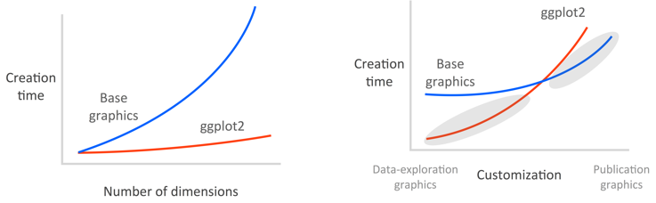
Graphics in R: overview
Image from http://seananderson.ca/ggplot2-FISH554/

Slide 10
Base graphics: plot()
Plot is the generic function for plotting R objects
points, lines, etc.
Read in the "primates.csv" data
> primates <- read.csv(file="primates.csv", header=T)
> primates
X Bodywt Brainwt
1 Potar monkey 10.0 115
2 Gorilla 207.0 406
3 Human 62.0 1320
4 Rhesus monkey 6.8 179
5 Chimp 52.2 440

Slide 11
Four ways to plot
> plot(x = primates$Bodywt, y = primates$Brainwt)
> plot(Brainwt ~ Bodywt, data = primates)
> attach(primates)
> plot(x = Brainwt, y = Bodywt)
> detach(primates)
> with(primates, plot(x = Brainwt, y = Bodywt))
My preferred way
Sometimes used, uses formulas (~) that are common in statistical models
Confusing: in the second line, where did object Brainwt come from?
with() does attaching and detaching for a single expression

Slide 12
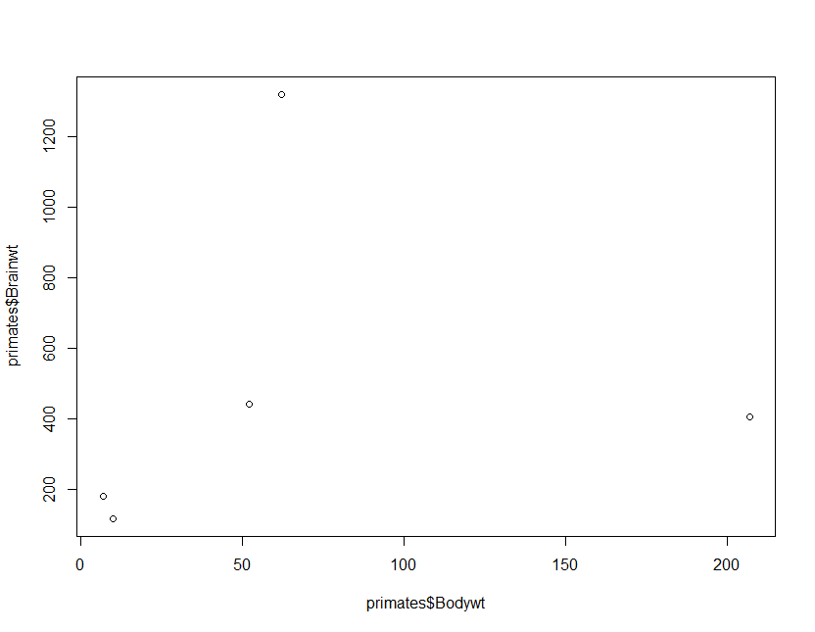
To be frank, this plot is a little boring!

Slide 13
Labels on the axes
By default R uses the name of the variables as axis labels
Use the xlab and ylab options to change the labels
plot(x = primates$Bodywt, y = primates$Brainwt,
xlab = "Body weight (kg)",
ylab = "Brain weight (g)")

Slide 14
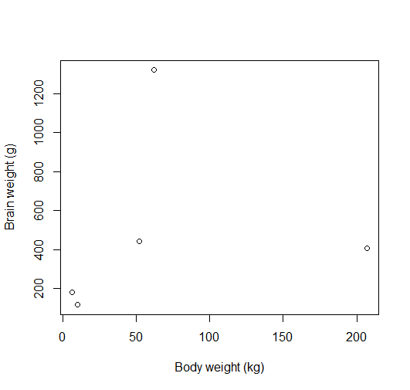

Slide 15
Limits of the axes
By default, R chooses x and y limits that are just larger (4%) than the range of your data
May or may not include zero
To change the default x and y values use xlim and ylim
plot(x = primates$Bodywt, y = primates$Brainwt,
xlim=c(0,300), ylim=c(0,1400))

Slide 16
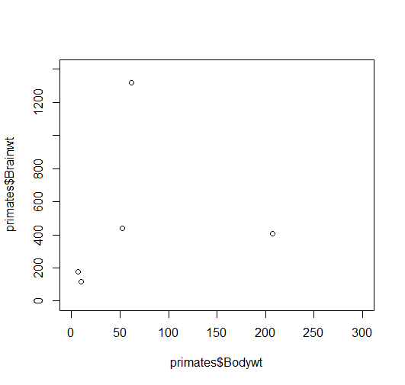

Slide 17
Remove space around zero
R adds space between the axis and 0
This makes true zeros look like they are non-zeros
To remove this, use xaxs="i" and yaxs="i" together with xlim and ylim
plot(x = primates$Bodywt, y = primates$Brainwt,
xlim=c(0,300), ylim=c(0,1400),
xaxs="i", yaxs="i")

Slide 18
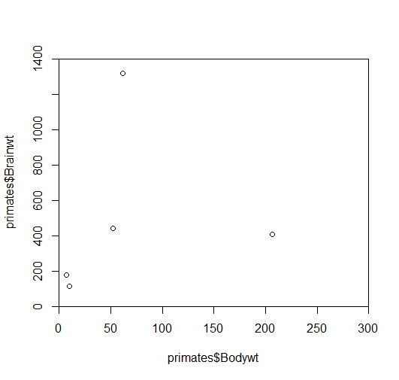

Slide 19
Using colors in R
Colors of points, lines, text etc. can all be specified
Colors can be applied to various plot parts
col (default color)
col.axis (tick mark labels)
col.lab (x label and y label)
col.main (title of the plot)
Colors can be specified as numbers or text strings
col=1 or col="red"
plot(x = primates$Bodywt, y = primates$Brainwt,
xlim=c(0,300), ylim=c(0,1400),
xaxs="i", yaxs="i", col="blue")

Slide 20
